Slide 1
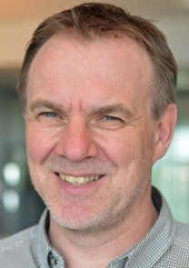
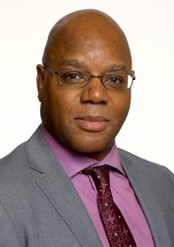
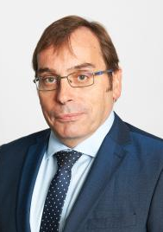
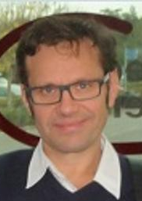
Architects Empathy Map
Think
See
Satisfied with current online and classroom courses. Reference materials, how-to guides and job aids are not there and not consolidated in one place. Safe environment required for testing technology solutions before taking it out to the customer. Document sharing can be a hit-miss. Difficult for new hires or young employees to find the correct training .
Working with the architect community and connecting with others of the same profession helped them. Accessing e-learning can be difficult. Weekly newsletter is interesting and a good way to keep up to date. Practical approach of working on a case study together in a classroom is a good option.
Thorbjorn Ellefsen Norway
Devon Burke UK
Searchability of resources is painful. Not enough time to take formal courses due to work pressure. Continuous learning is important. Learning content needs to be future proof. They don’t know what they can do it on their mobile.
Online books, Technotrends app
Online search, Newsletters, Blogs. Local Platforms, Wiki, Ticker to Subscribe, Slack , Yammer.
Mark Evanson UK
Roman Szkwarok UK
Feel
Do

Slide 2
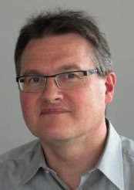
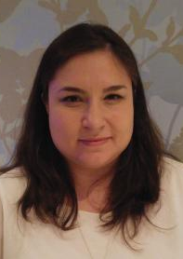
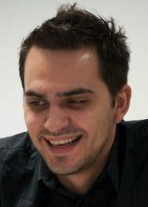
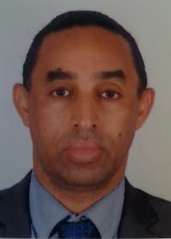
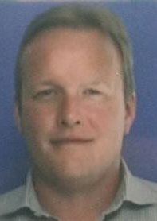
Architects Empathy Map
Think
See
Due to busy schedule it’s difficult to find time to search for online learning materials. Would rather access materials that comes on email. Access to recommended courses, materials and job-aids is required. It’s difficult to find materials on MyLearning and User Experience is not good. Pluralsight User Experience is awesome.
Talent pages are good, specially the features like ratings and comments. But not sure if Talent is accessible from Smartphone. Want to find out what other colleagues are saying about a particular learning intervention.
Thomas Grossmann Germany
Adina Lordache Romania
George Bosincianu Romania
Matias Aranos UK
Frustrated because not able to find resources.
Discouraged as there is no time for training and are very busy in client projects.
Tools that are being used are Pluralsight, Talent and Newsletter. My Learning has not been accessed in 12 months. Patrice’s Newsletter and Gunnar’s Blog are very good due to availability on email.
Mike McMaster UK
Feel
Do

Slide 3
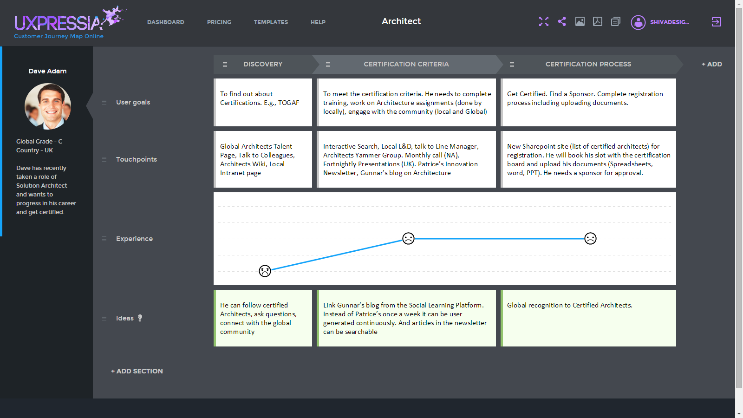
User Journey - Certification

